Slide 1
Drugs, Side Effects
and Medical Condition
arrow_drop_up
By-Rishav Kumar Sharma

Slide 2
Introduction
Exploratory Data Analysis (EDA) is a crucial step in understanding and uncovering insights from a dataset. In this project, we focus on analyzing the relationships between drugs, their side effects, and the medical conditions they treat.
The dataset includes valuable information such as the drug name, medical condition, side effects, drug classes, ratings, reviews, and more. By performing EDA, we aim to understand patterns, trends, and associations in the data, helping to identify insights that can be useful in medical and pharmaceutical contexts.

Slide 3
Objective
The main objectives of this EDA are:
To analyze the relationship between drugs and the medical conditions they treat.
To examine the frequency and impact of side effects across various drugs.
To explore user ratings and reviews to assess how well drugs are received by users.
To investigate how drug classes, prescription statuses, and other factors are related to drug ratings and side effects.

Slide 4
Scope
This analysis will cover the following aspects of the dataset:
Drugs and Medical Conditions: Explore the most commonly prescribed drugs for
various medical conditions.
Side Effects: Identify the most common side effects across different drugs.
Drug Ratings: Understand how drug ratings are distributed and the factors
Influencing them, including drug class and prescription status.
Reviews: Analyze the number of reviews and how they relate to the ratings.
Drug Classes and Categories: Examine drug classifications and how they
relate to side effects and ratings.

Slide 5
Steps
Data Import and Setup:
Import necessary libraries like Pandas, Matplotlib, and Seaborn for data manipulation and visualization.
Load the dataset into a Pandas DataFrame.
Data Cleaning:
Check for missing or null values and handle them accordingly, either by filling or dropping missing data.
Basic Data Exploration:
Generate summary statistics for numerical columns.
Visualize the distribution of drug ratings.

Slide 6
Analyzing Relationships:
Identify the most common drugs for each medical condition.
Explore the most frequent side effects across drugs.
Investigate the relationship between drug class and ratings using boxplots.
Advanced Analysis (Optional):
Perform further statistical or machine learning analysis if needed.
Conclusion:
Summarize the findings and insights derived from the analysis.

Slide 7
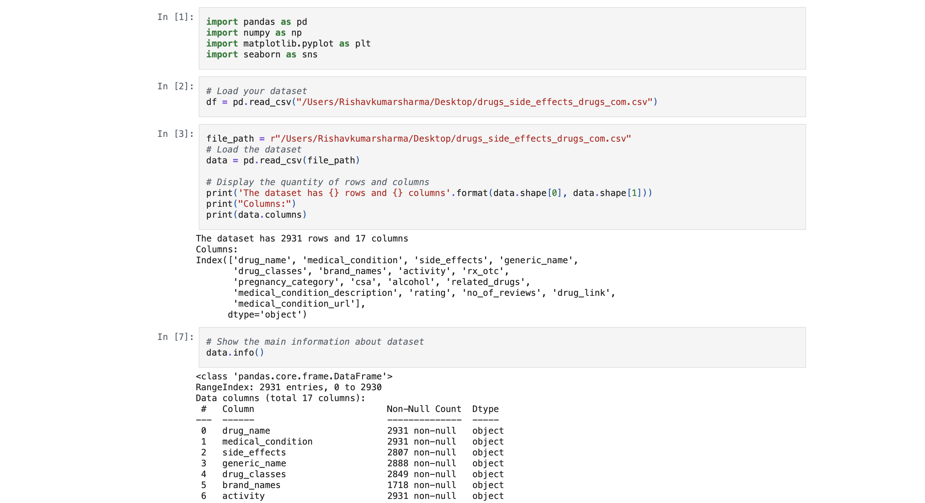


Slide 8
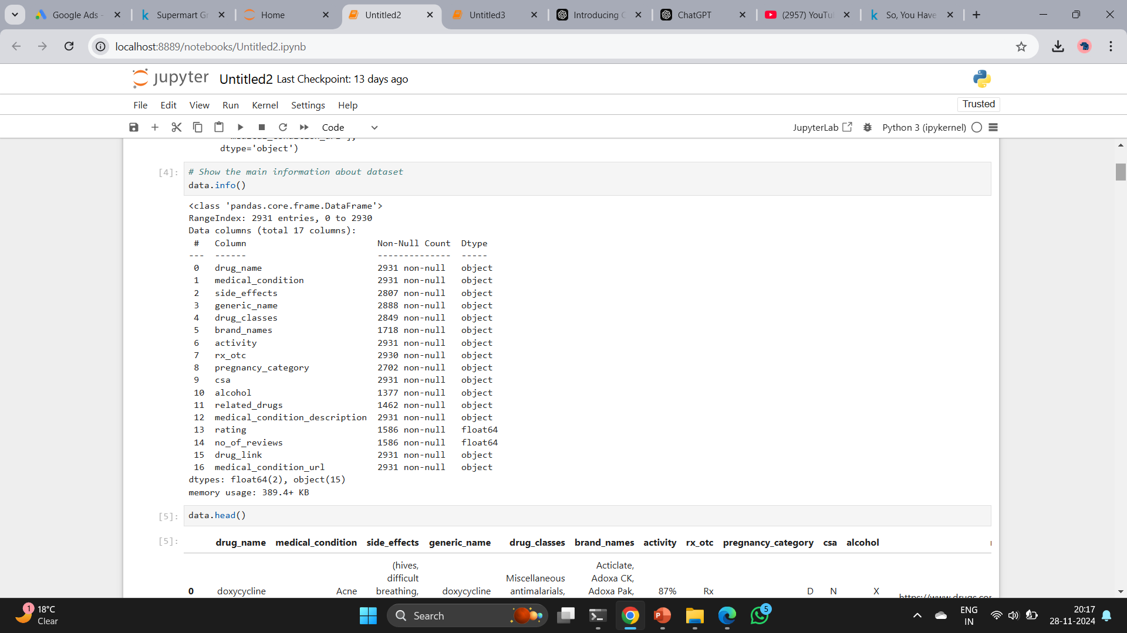

Slide 9
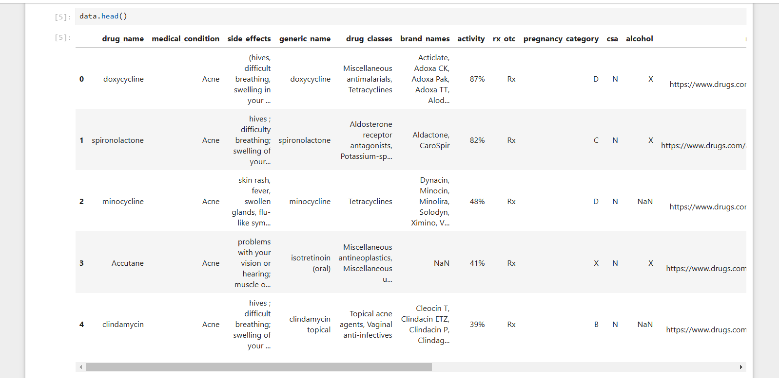

Slide 10
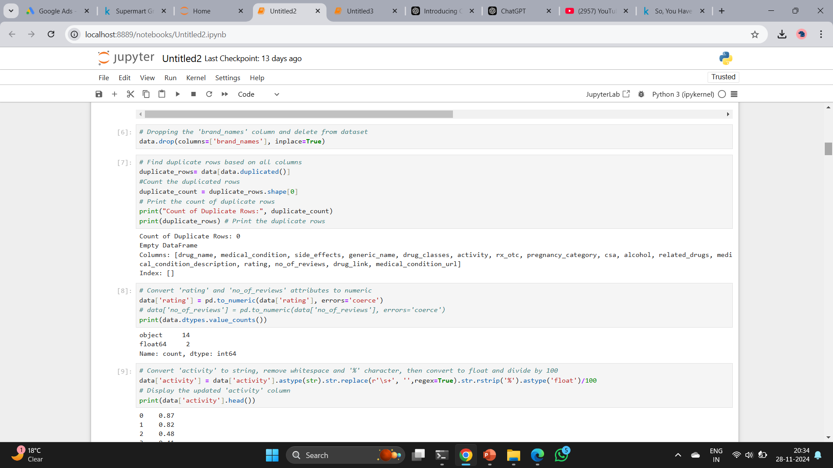

Slide 11
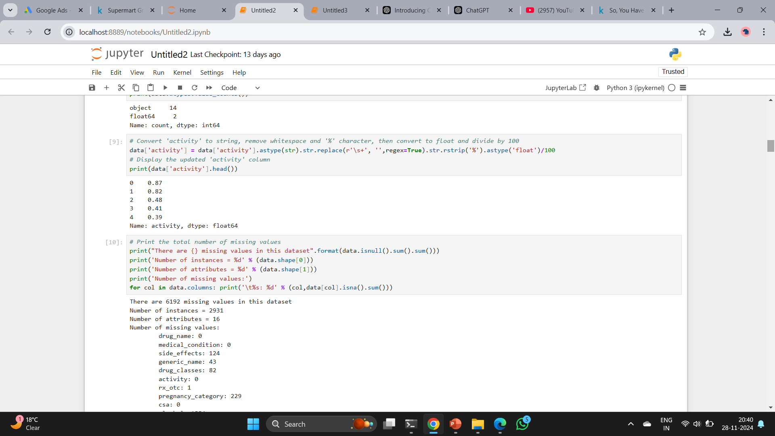

Slide 12
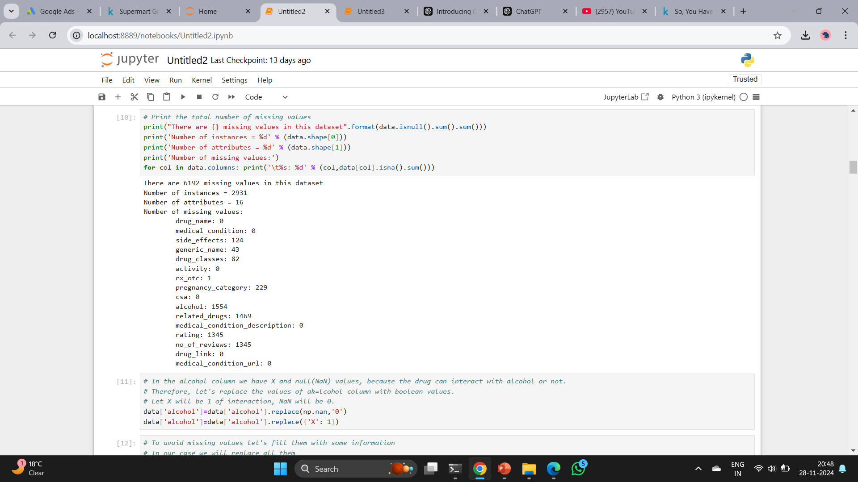

Slide 13
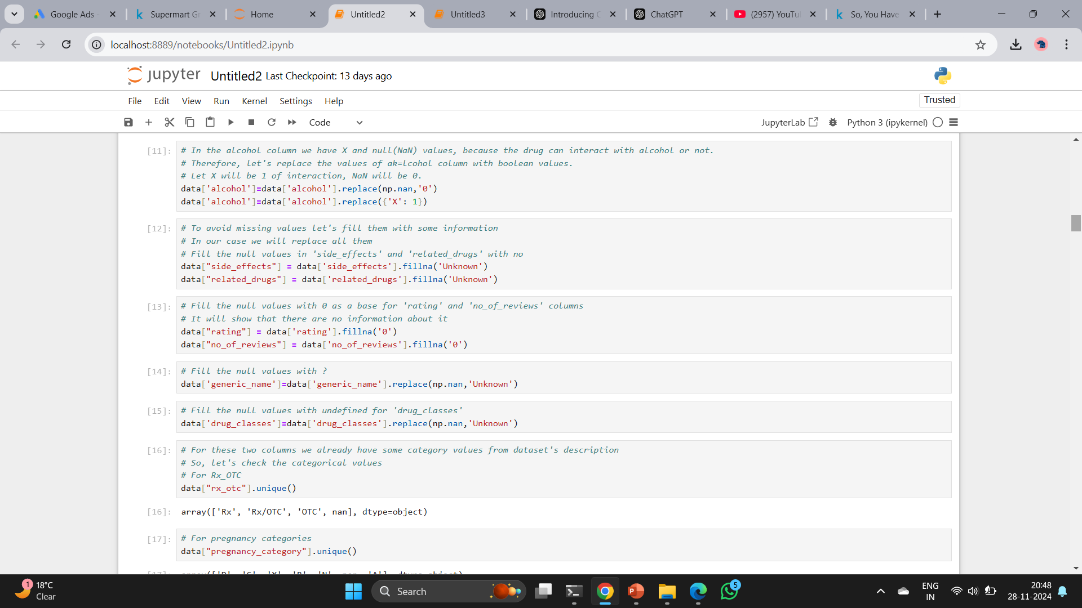

Slide 14
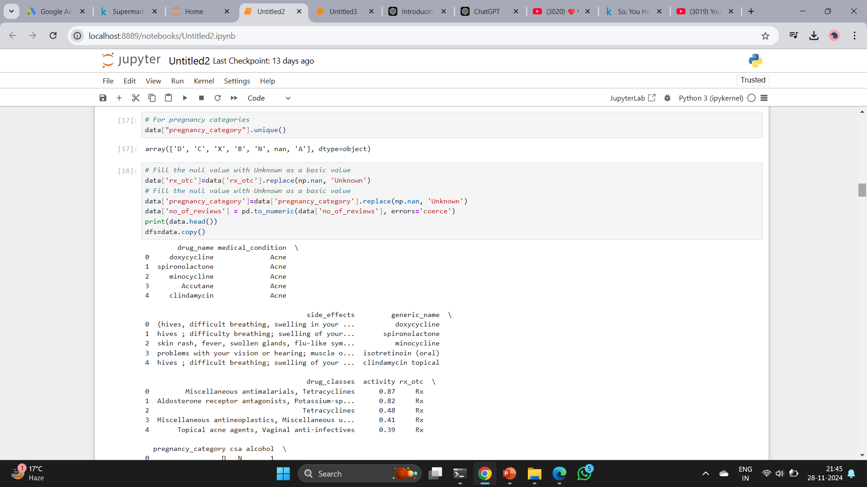

Slide 15
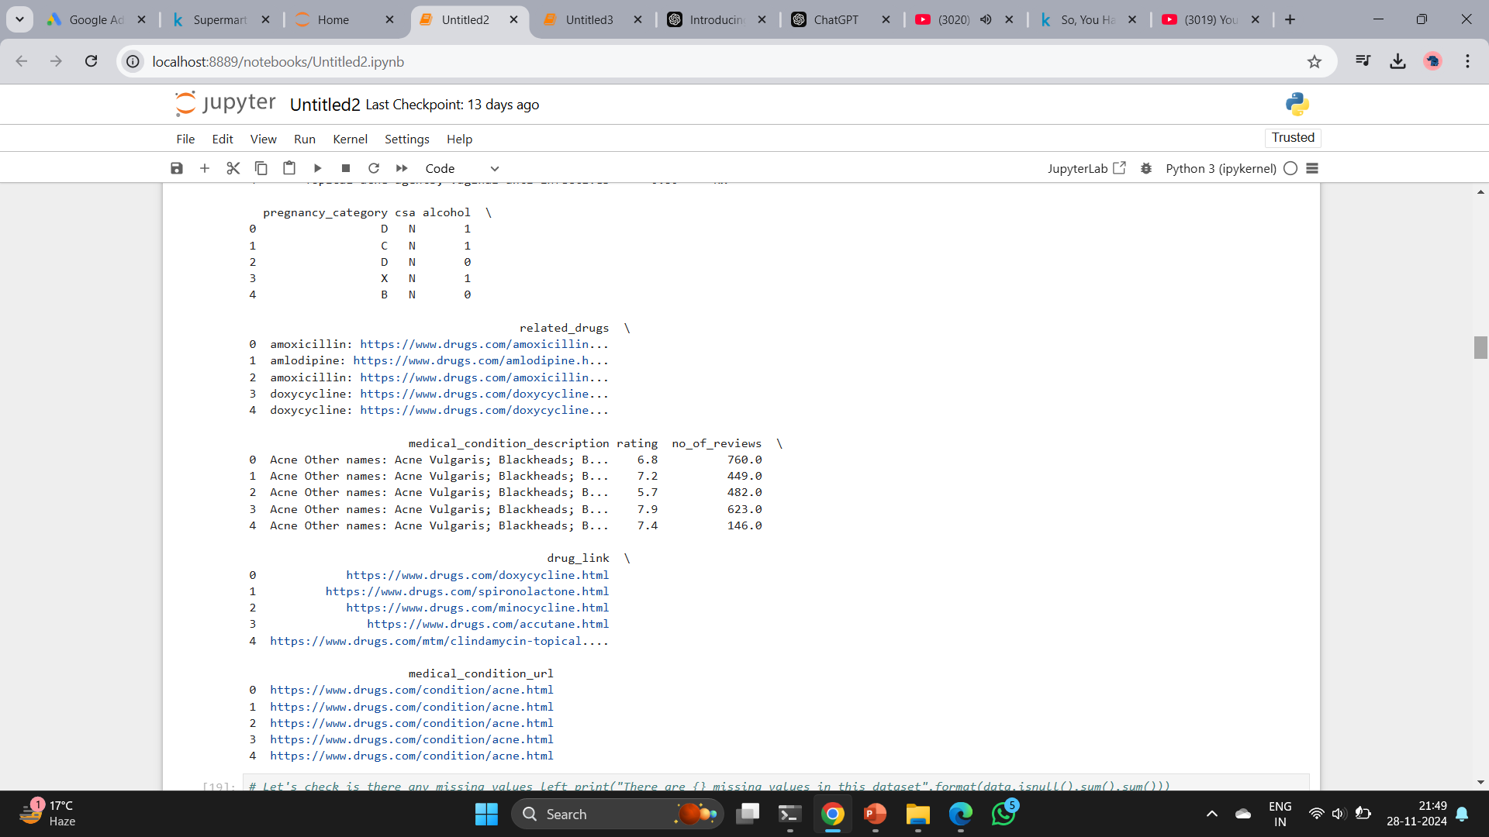

Slide 16
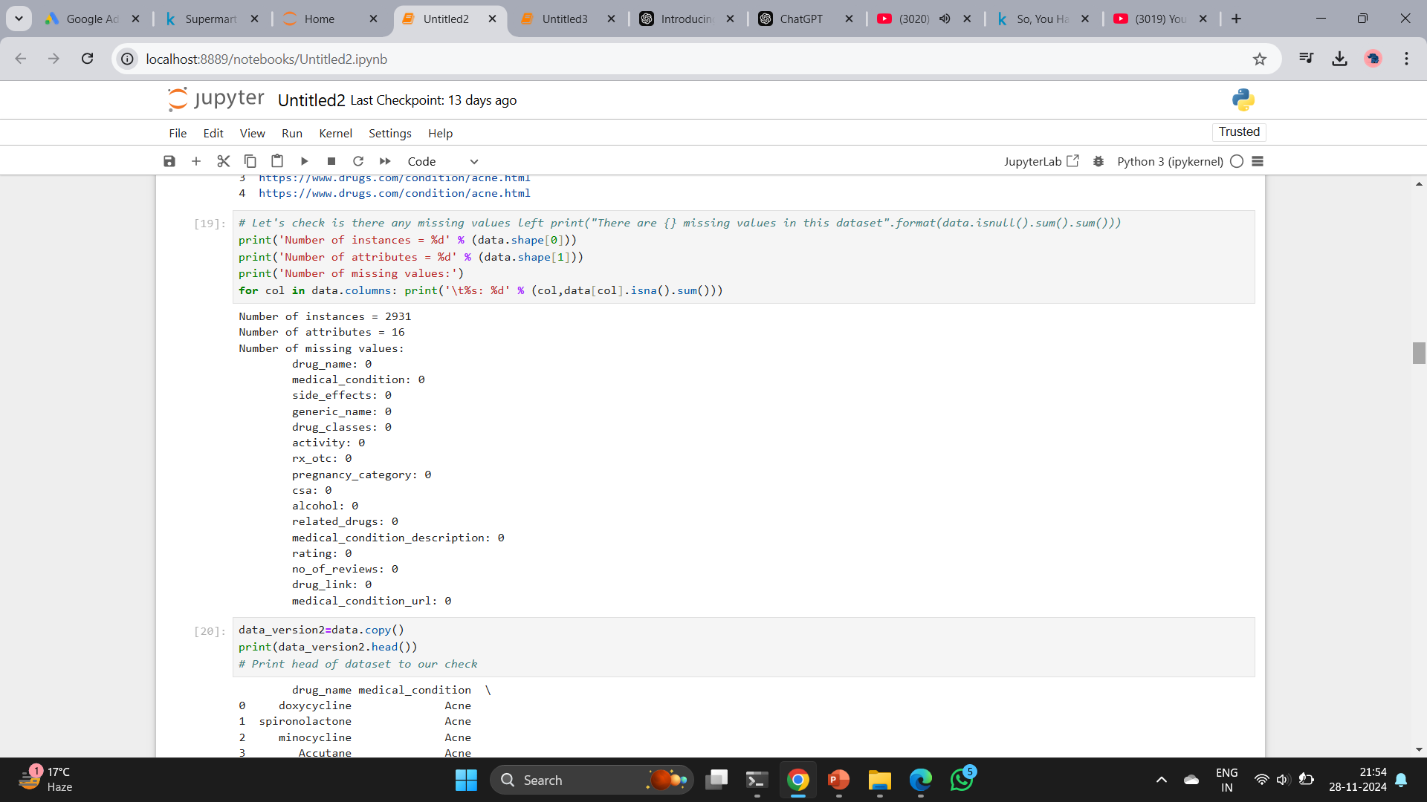

Slide 17
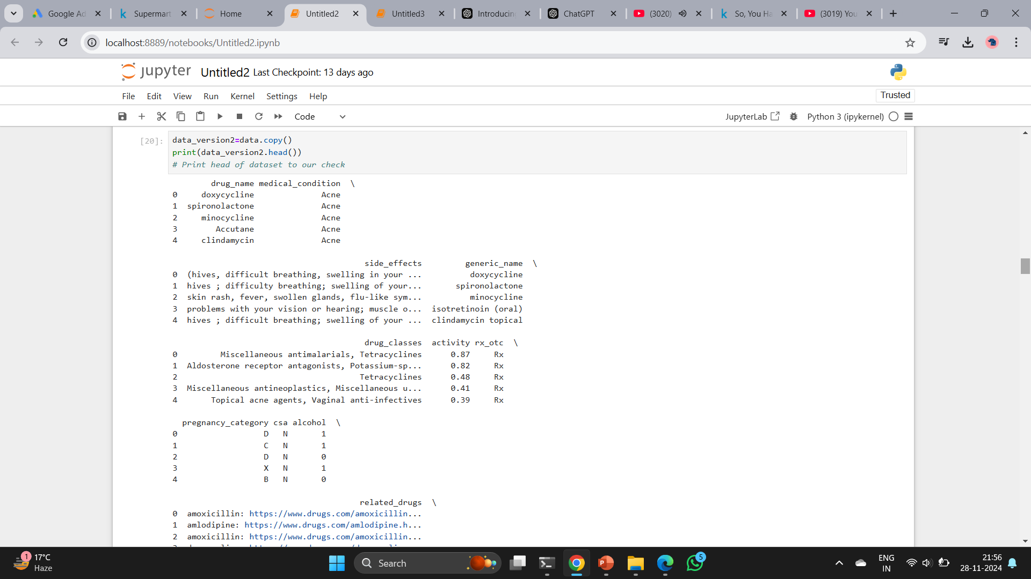

Slide 18
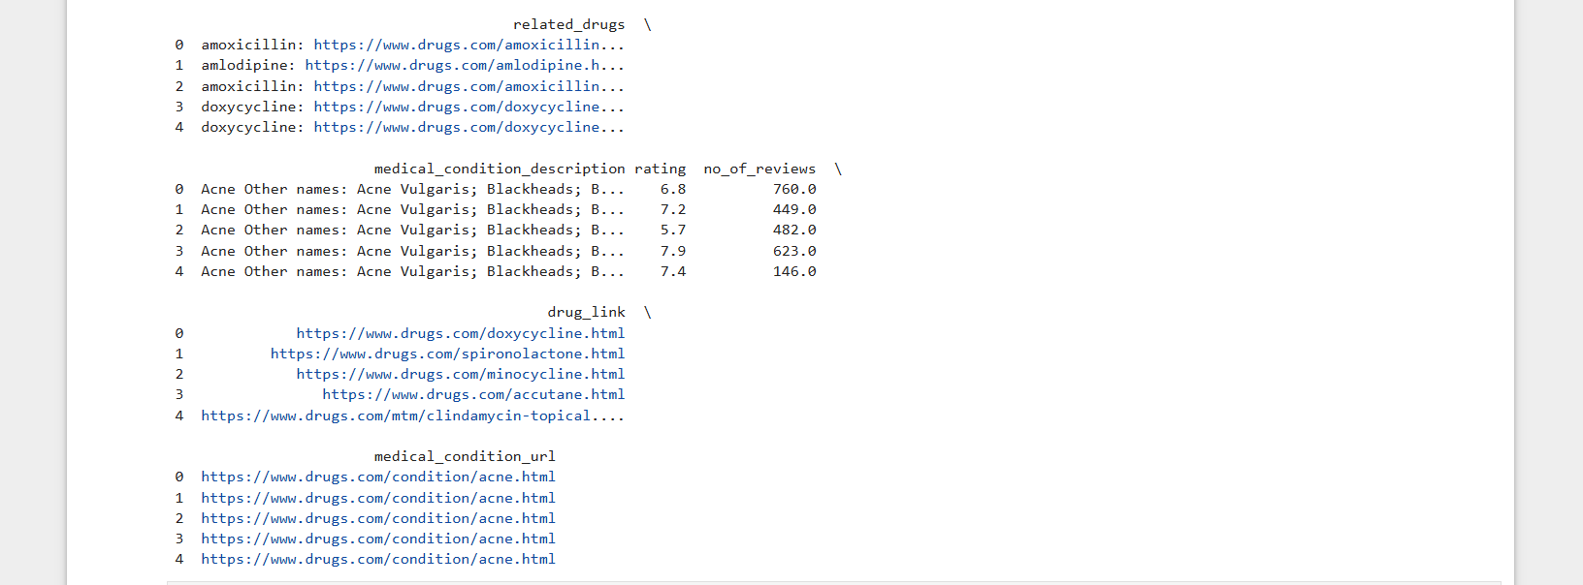

Slide 19
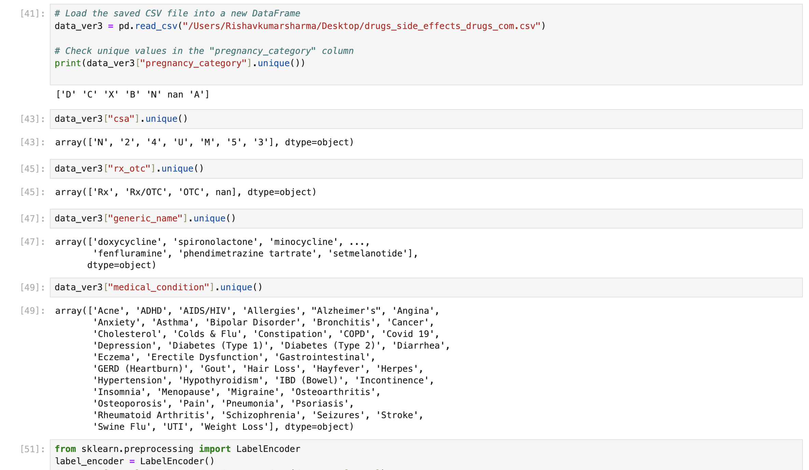

Slide 20
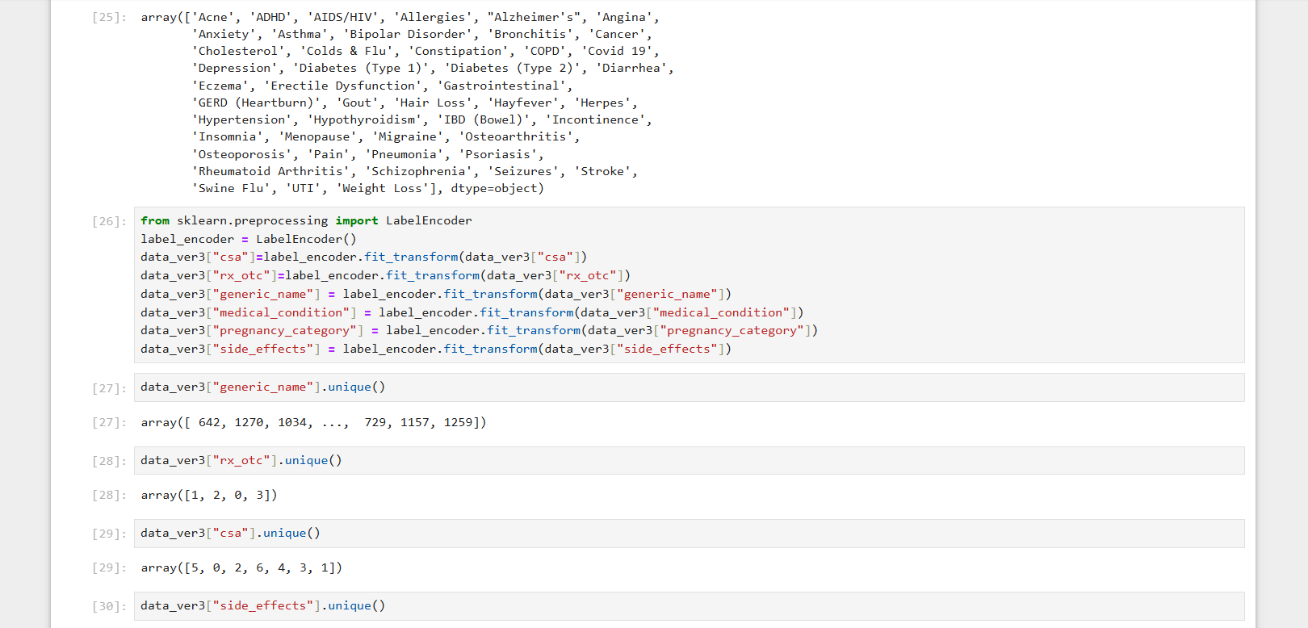

Slide 21
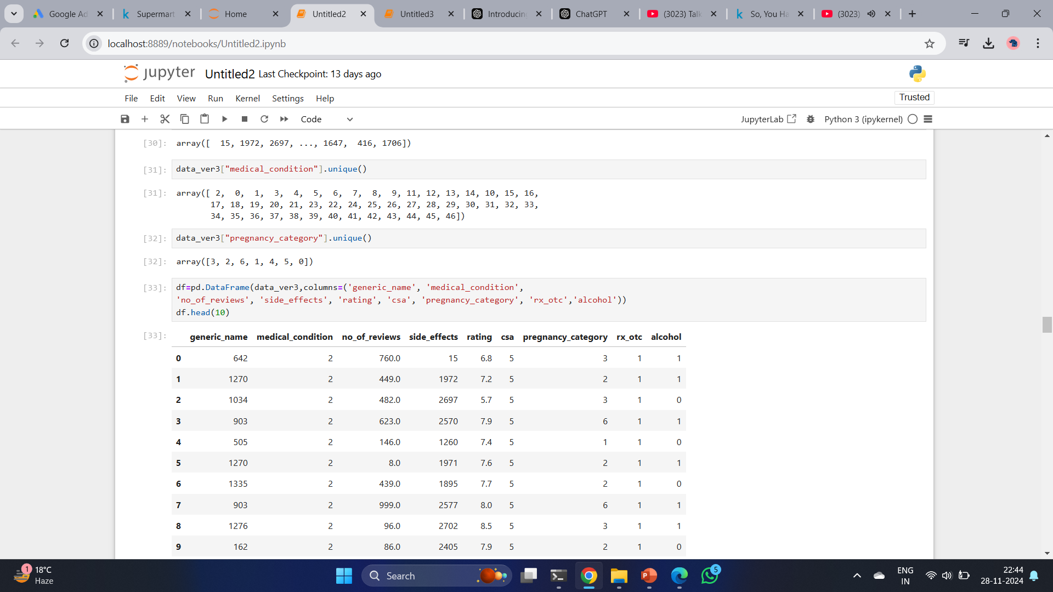

Slide 22
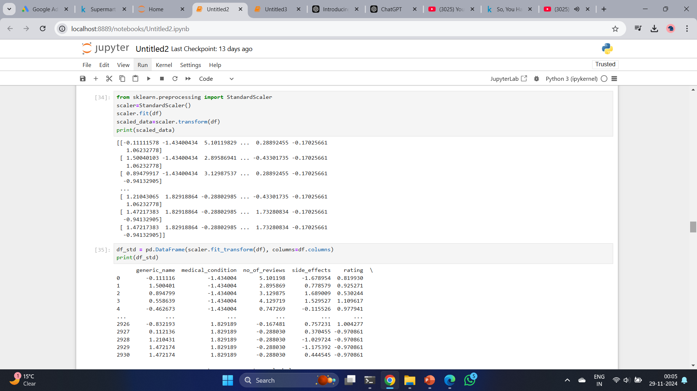

Slide 23
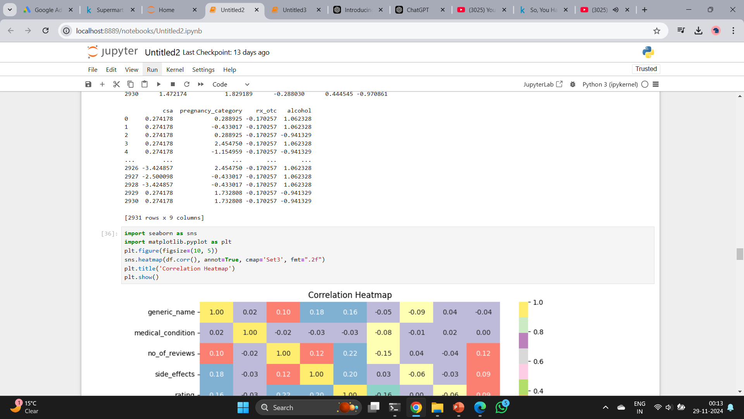

Slide 24
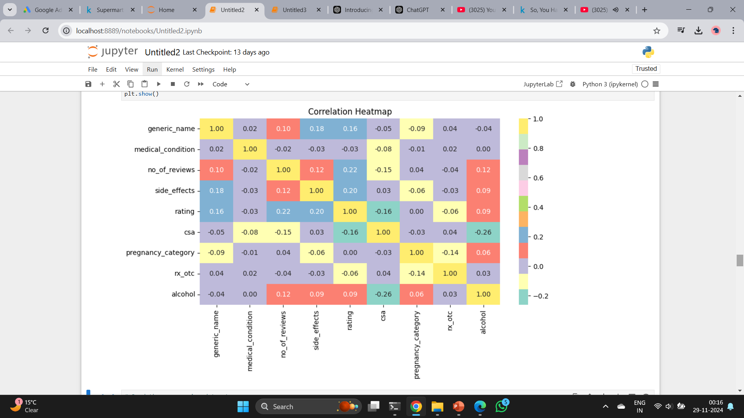

Slide 25
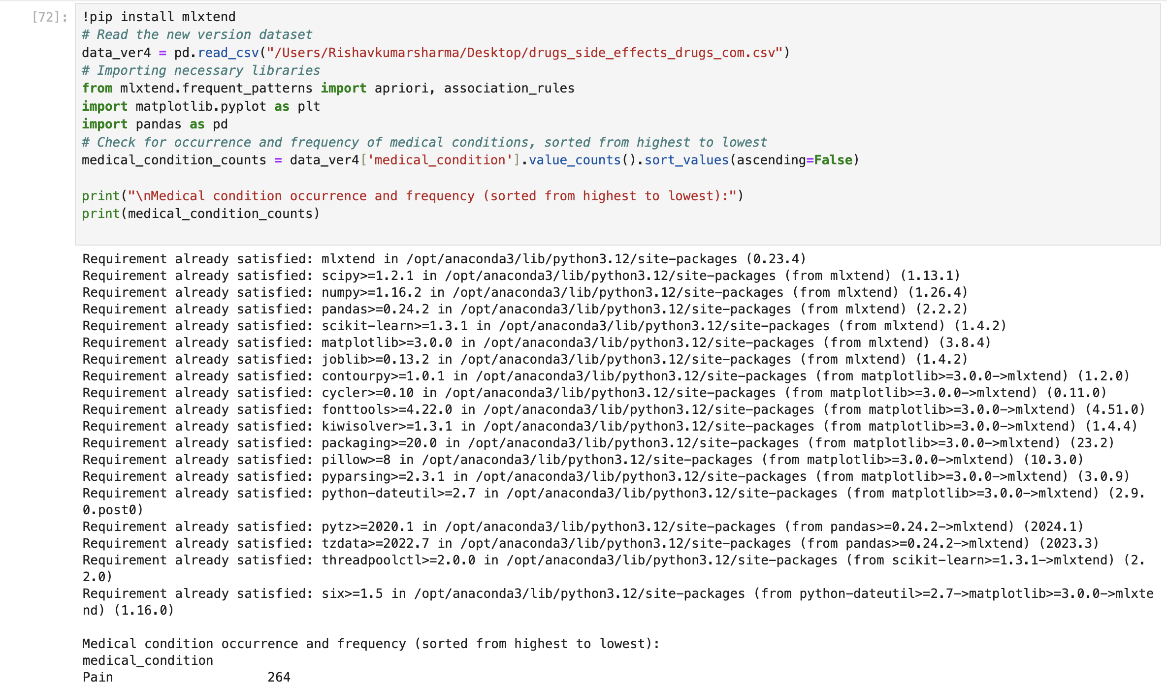

Slide 26
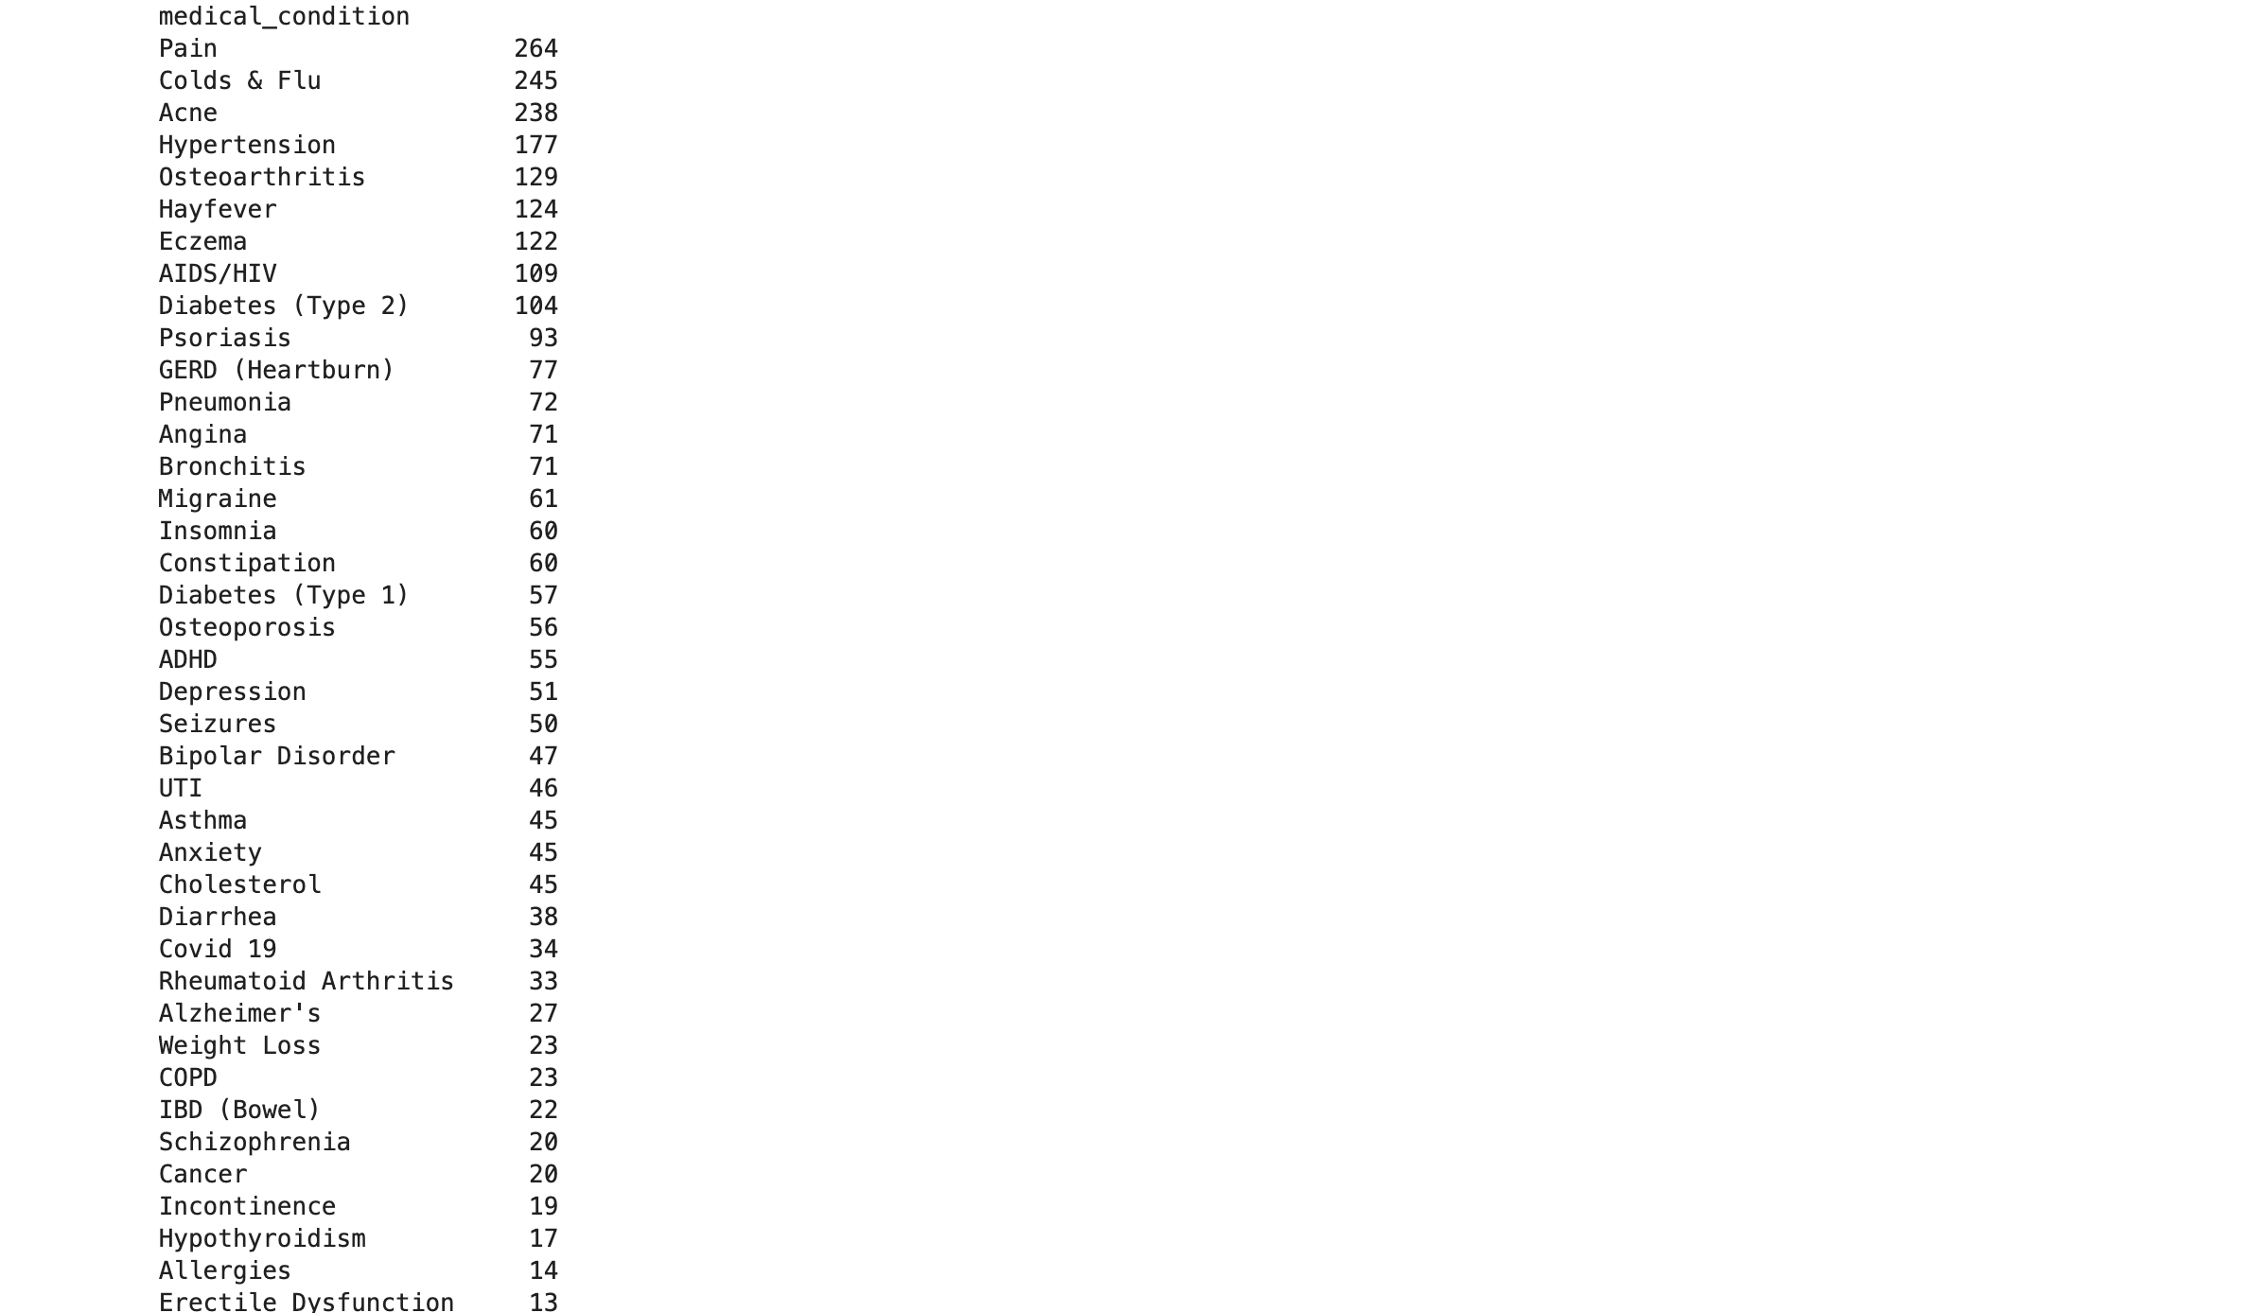
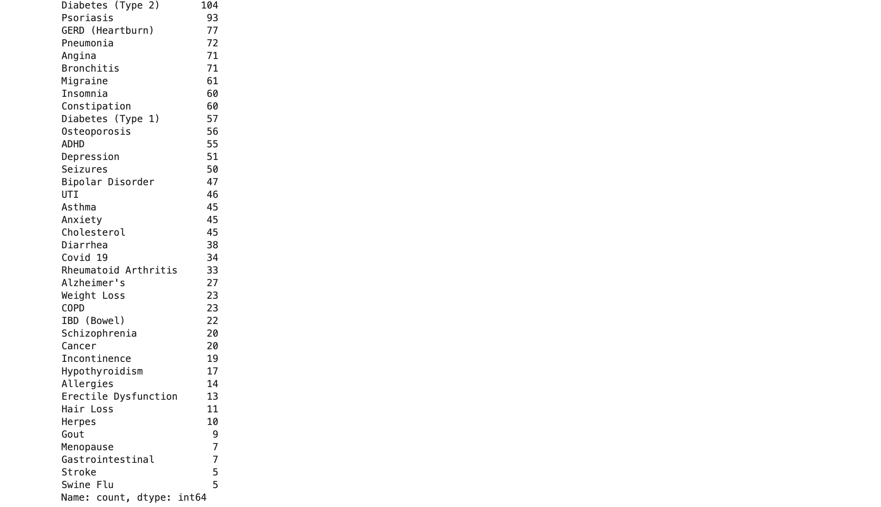

Slide 27
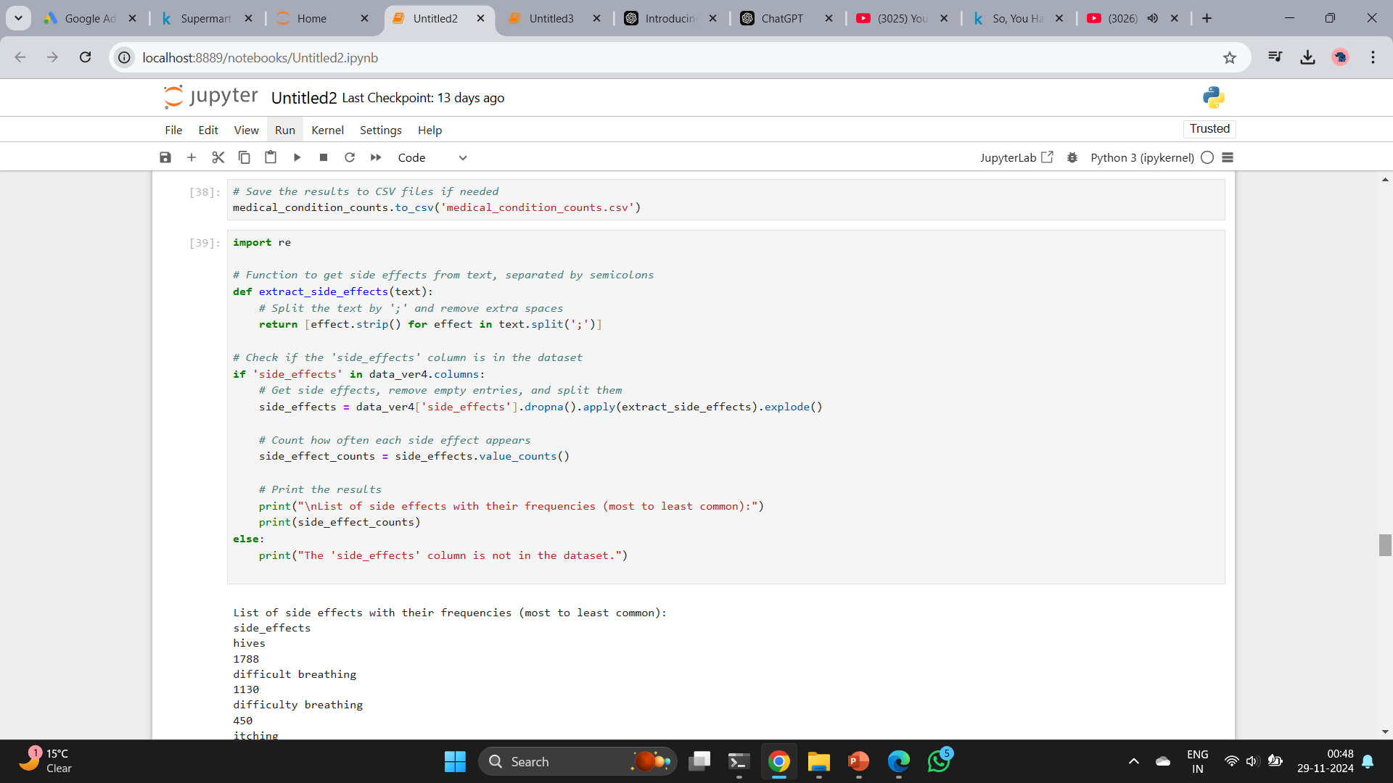

Slide 28
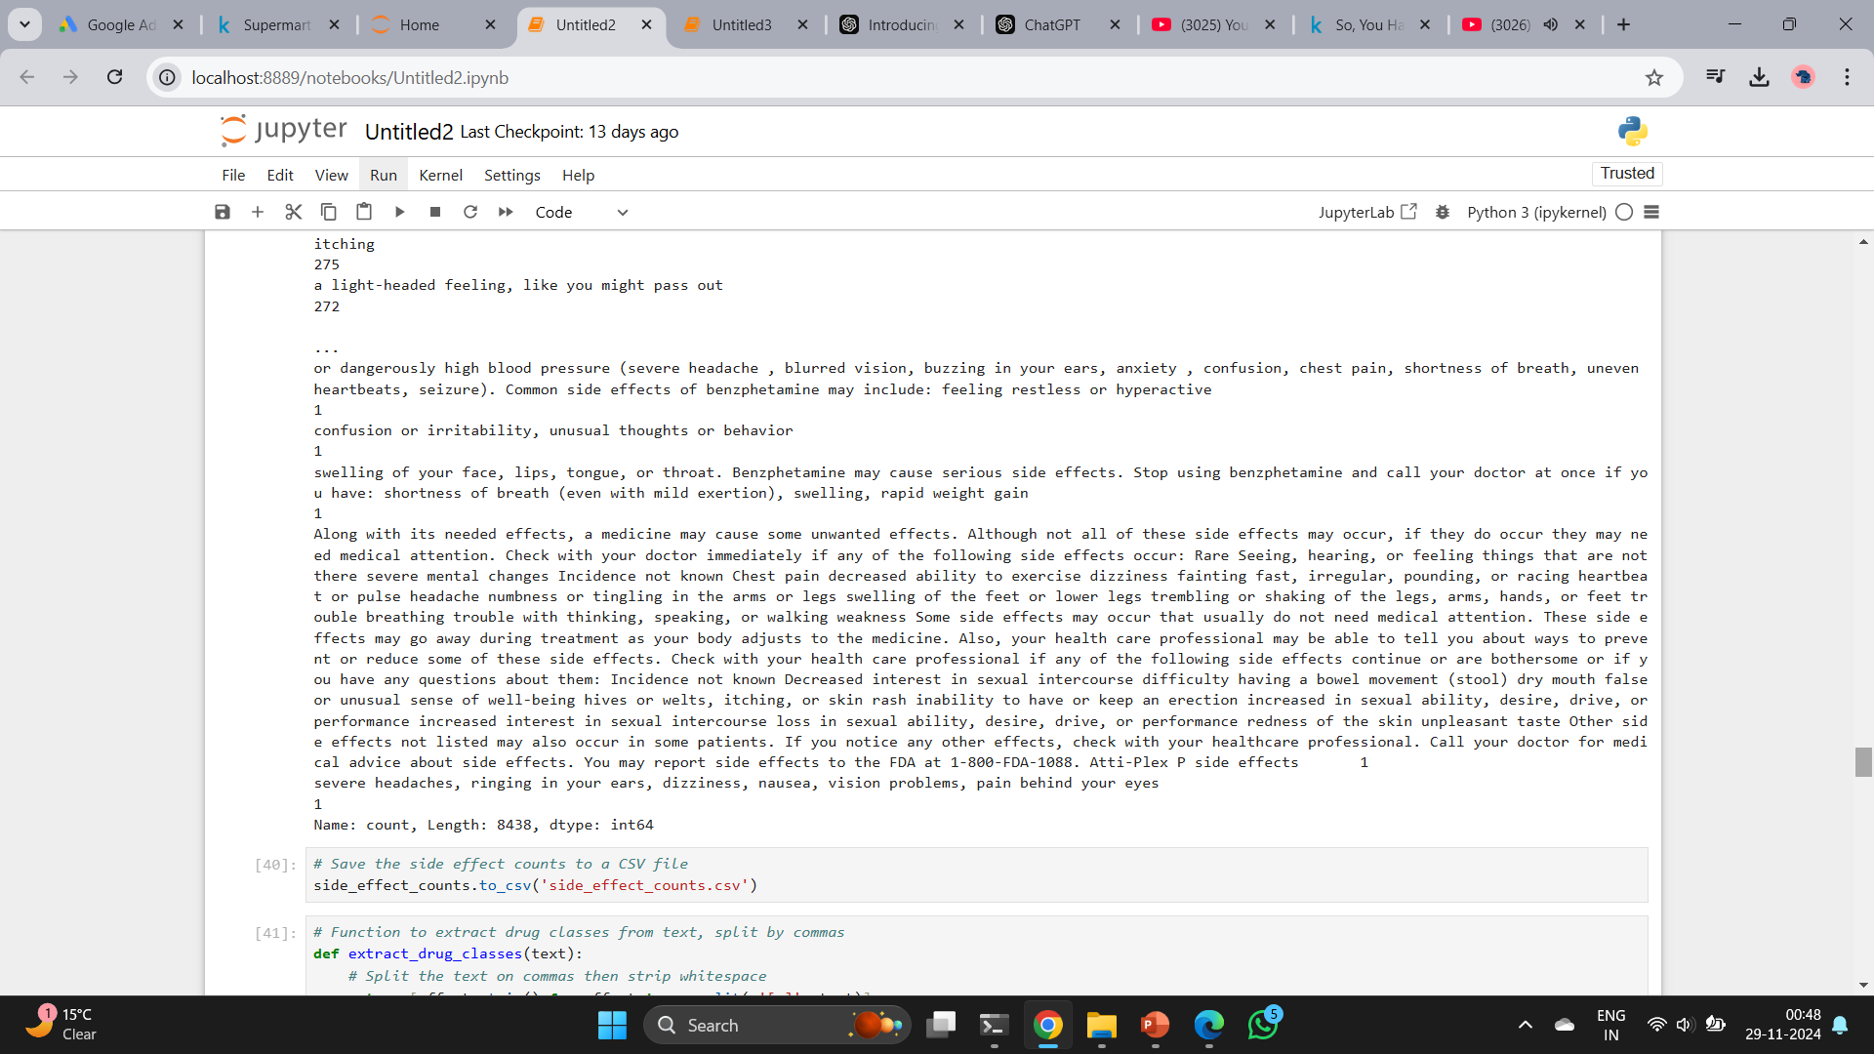

Slide 29
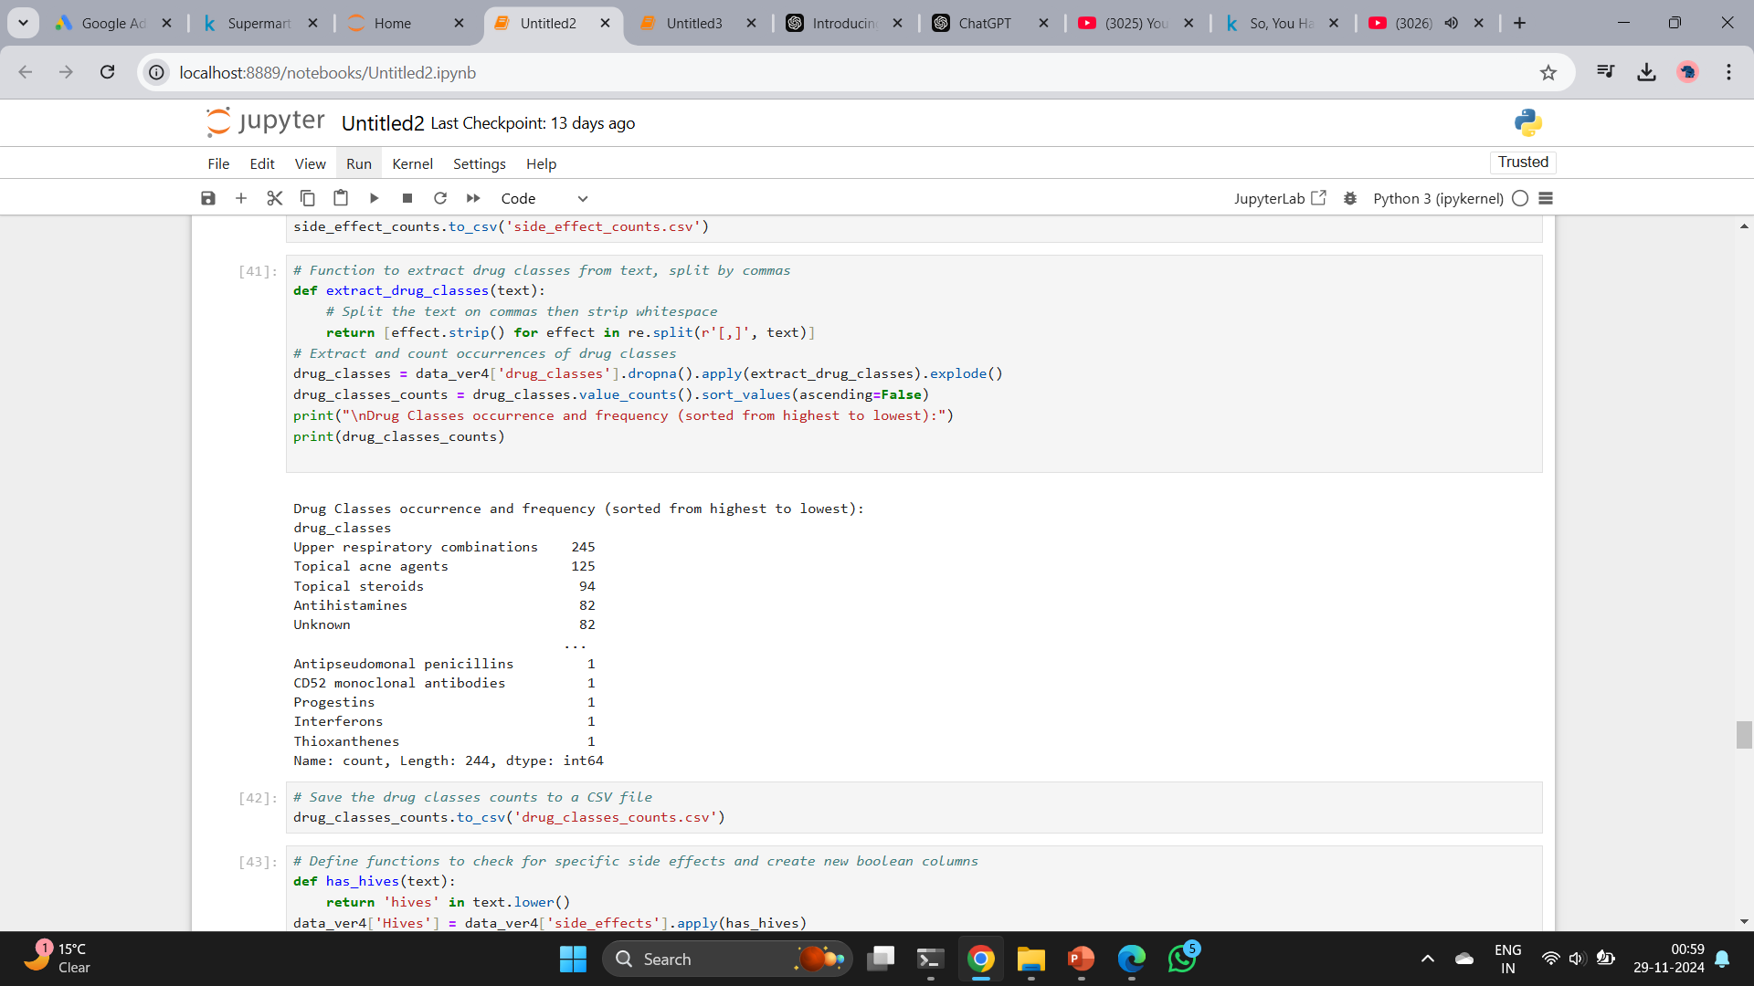

Slide 30
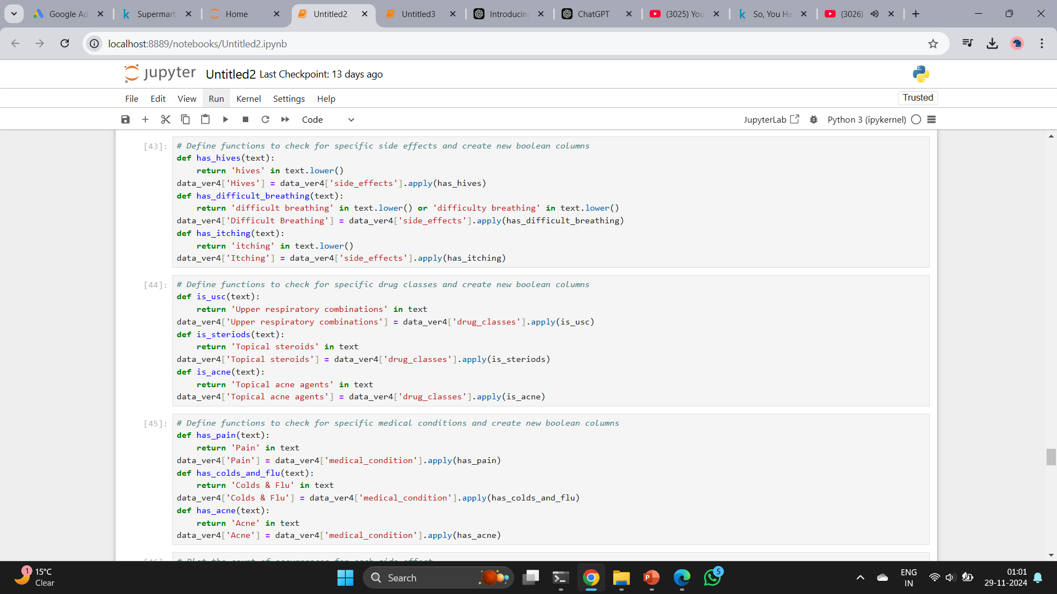

Slide 31
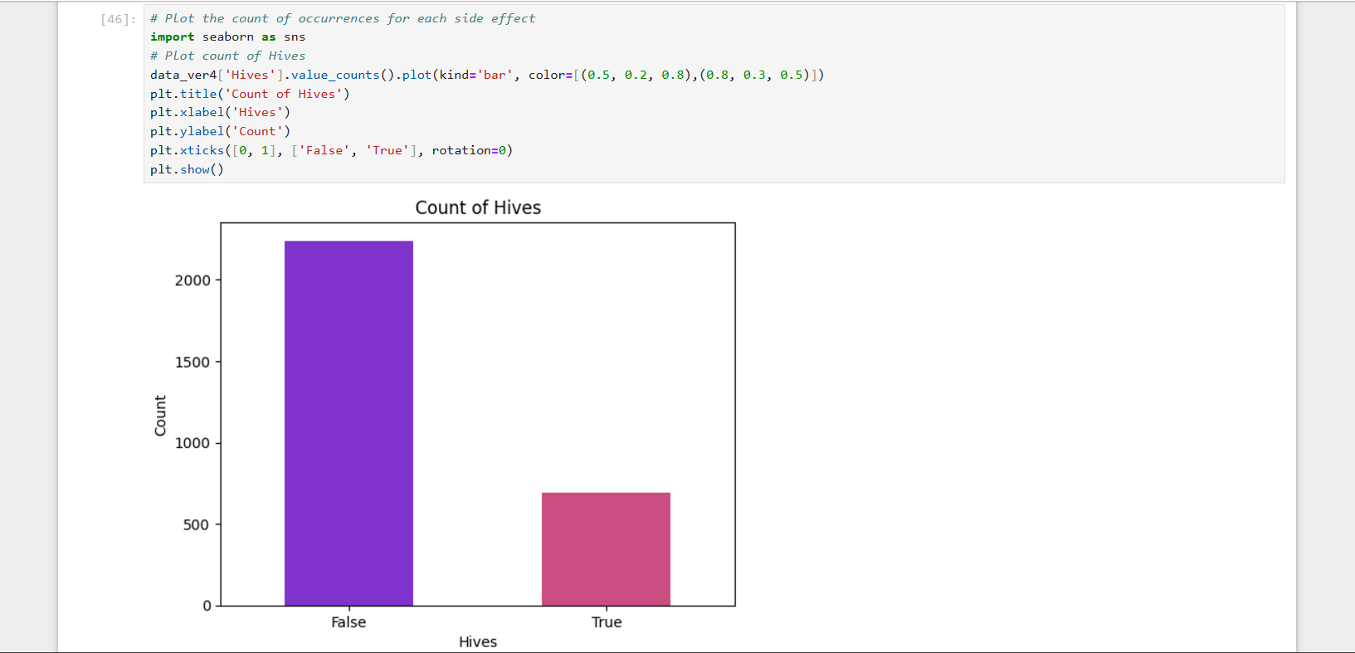

Slide 32
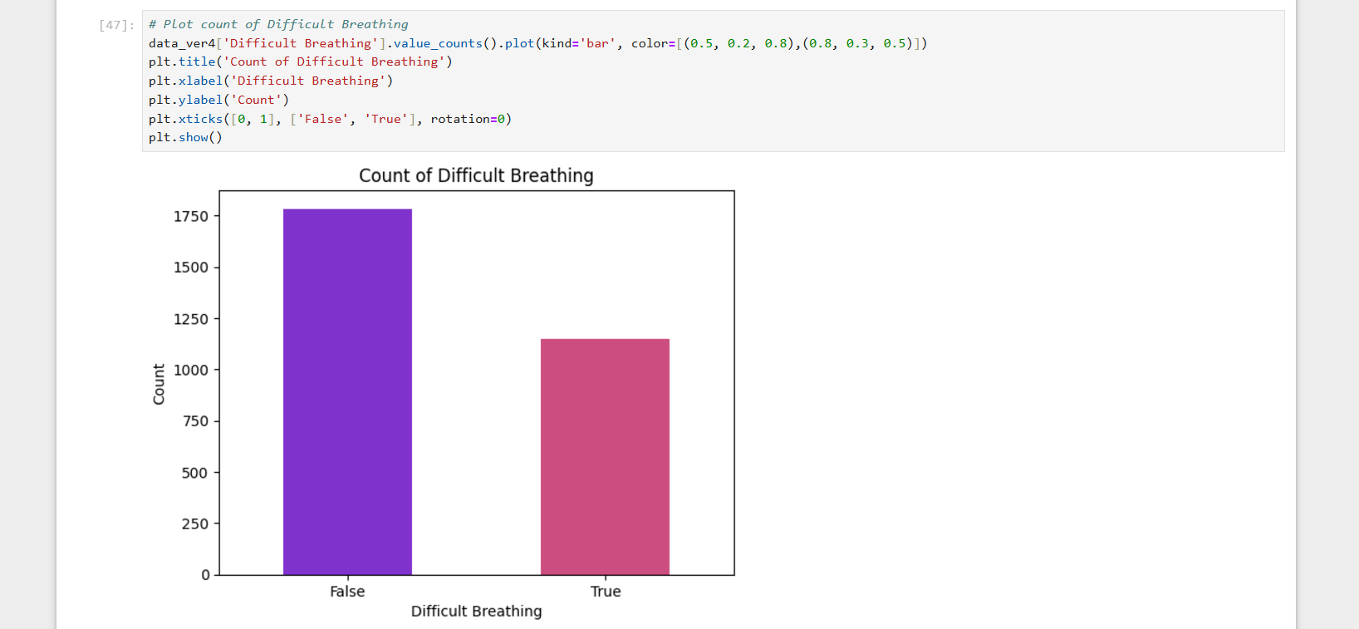

Slide 33
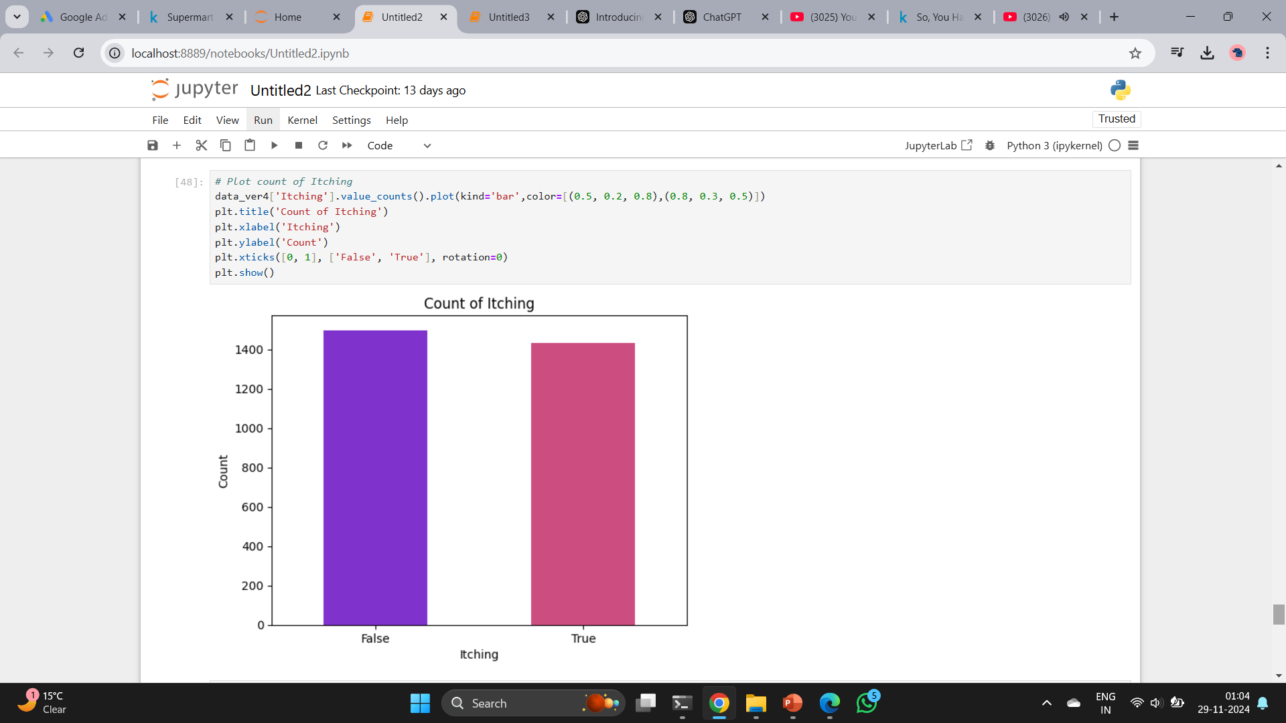

Slide 34
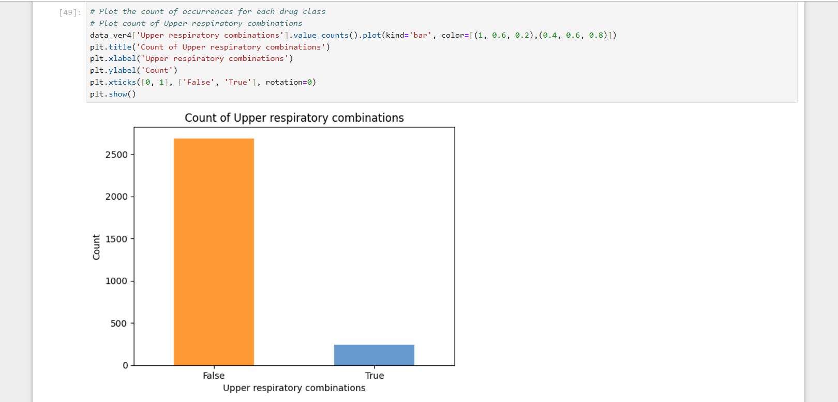

Slide 35
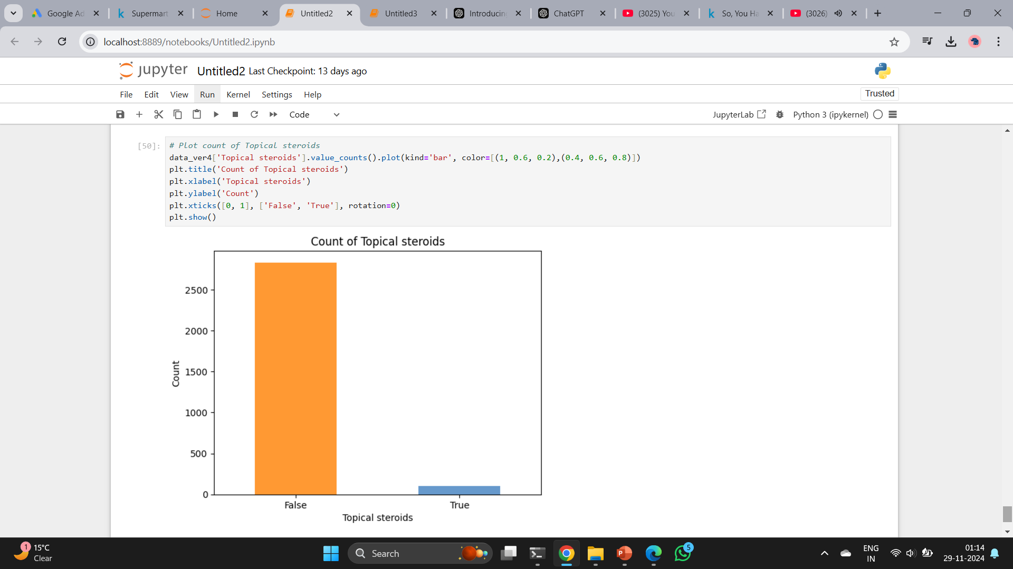

Slide 36
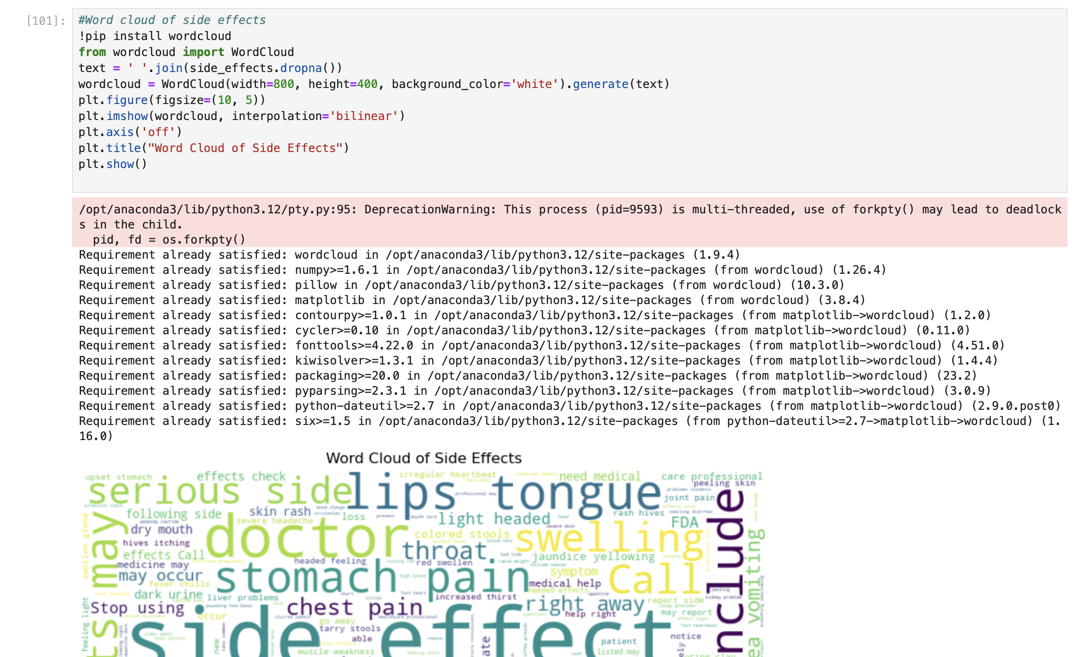

Slide 37
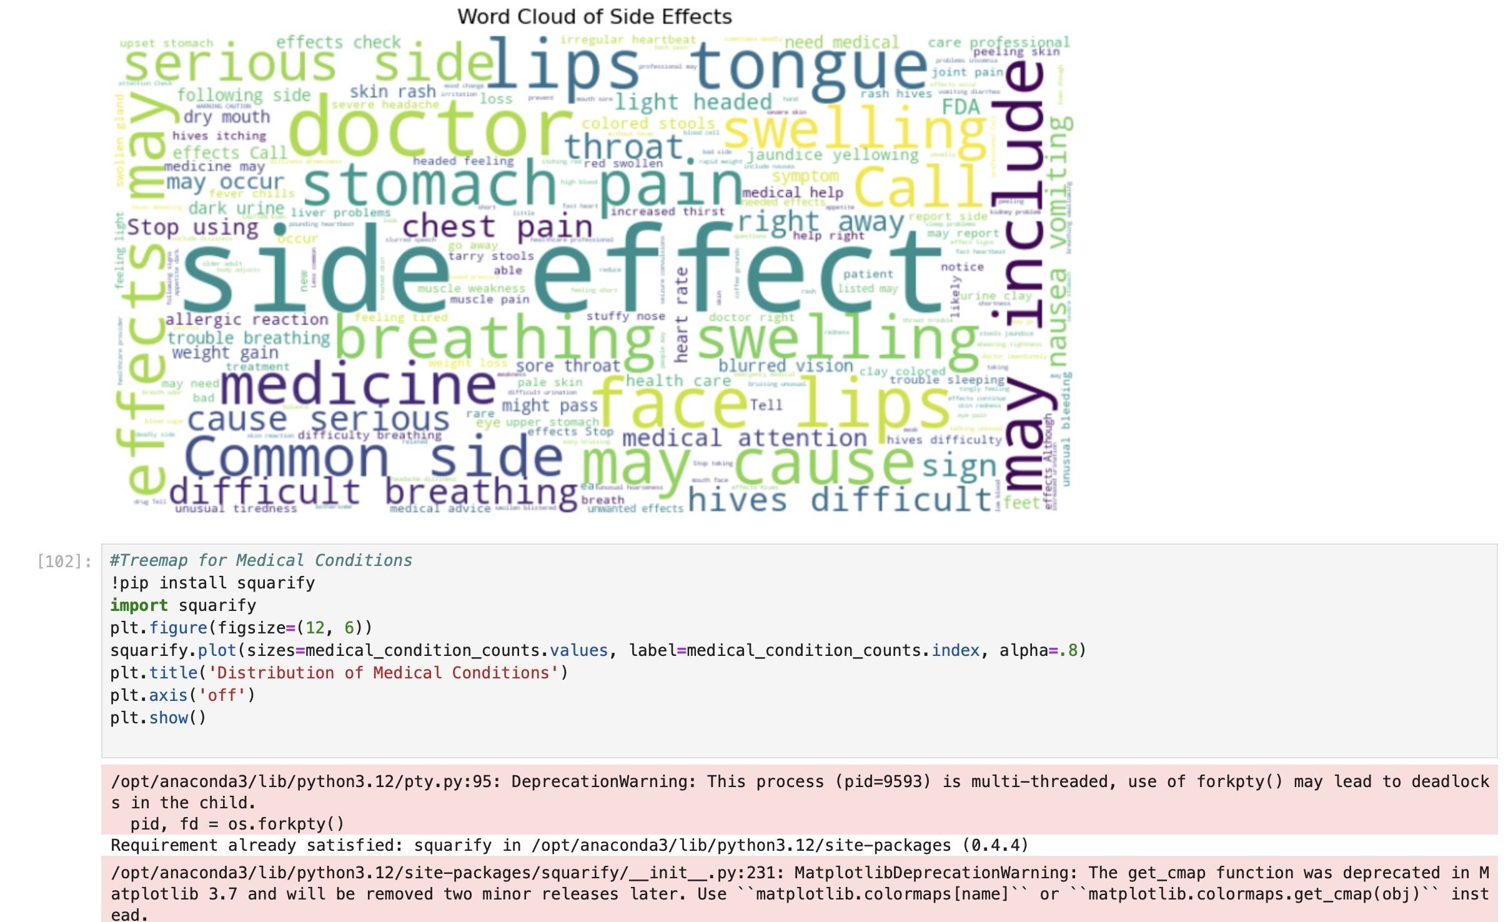

Slide 38
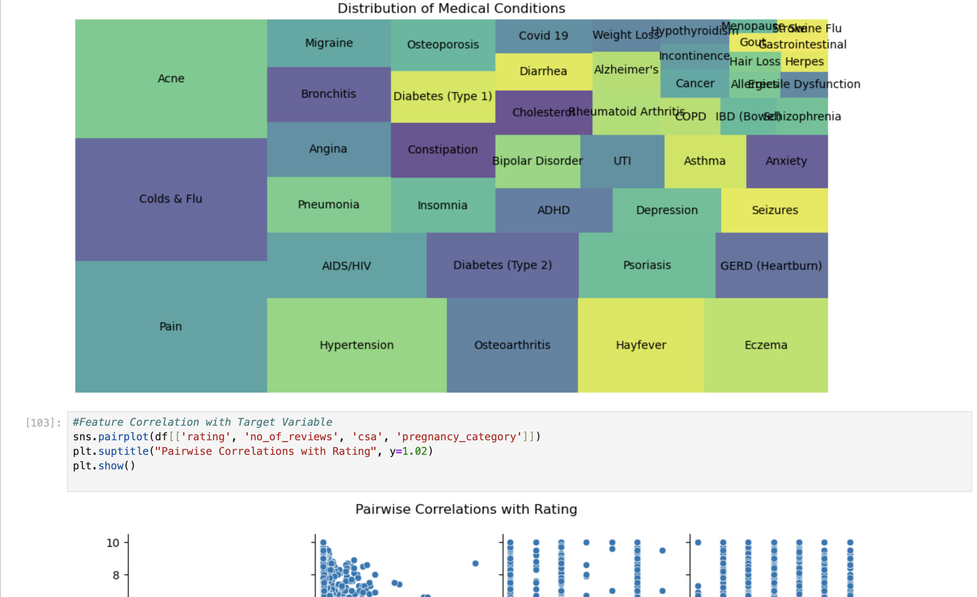

Slide 39
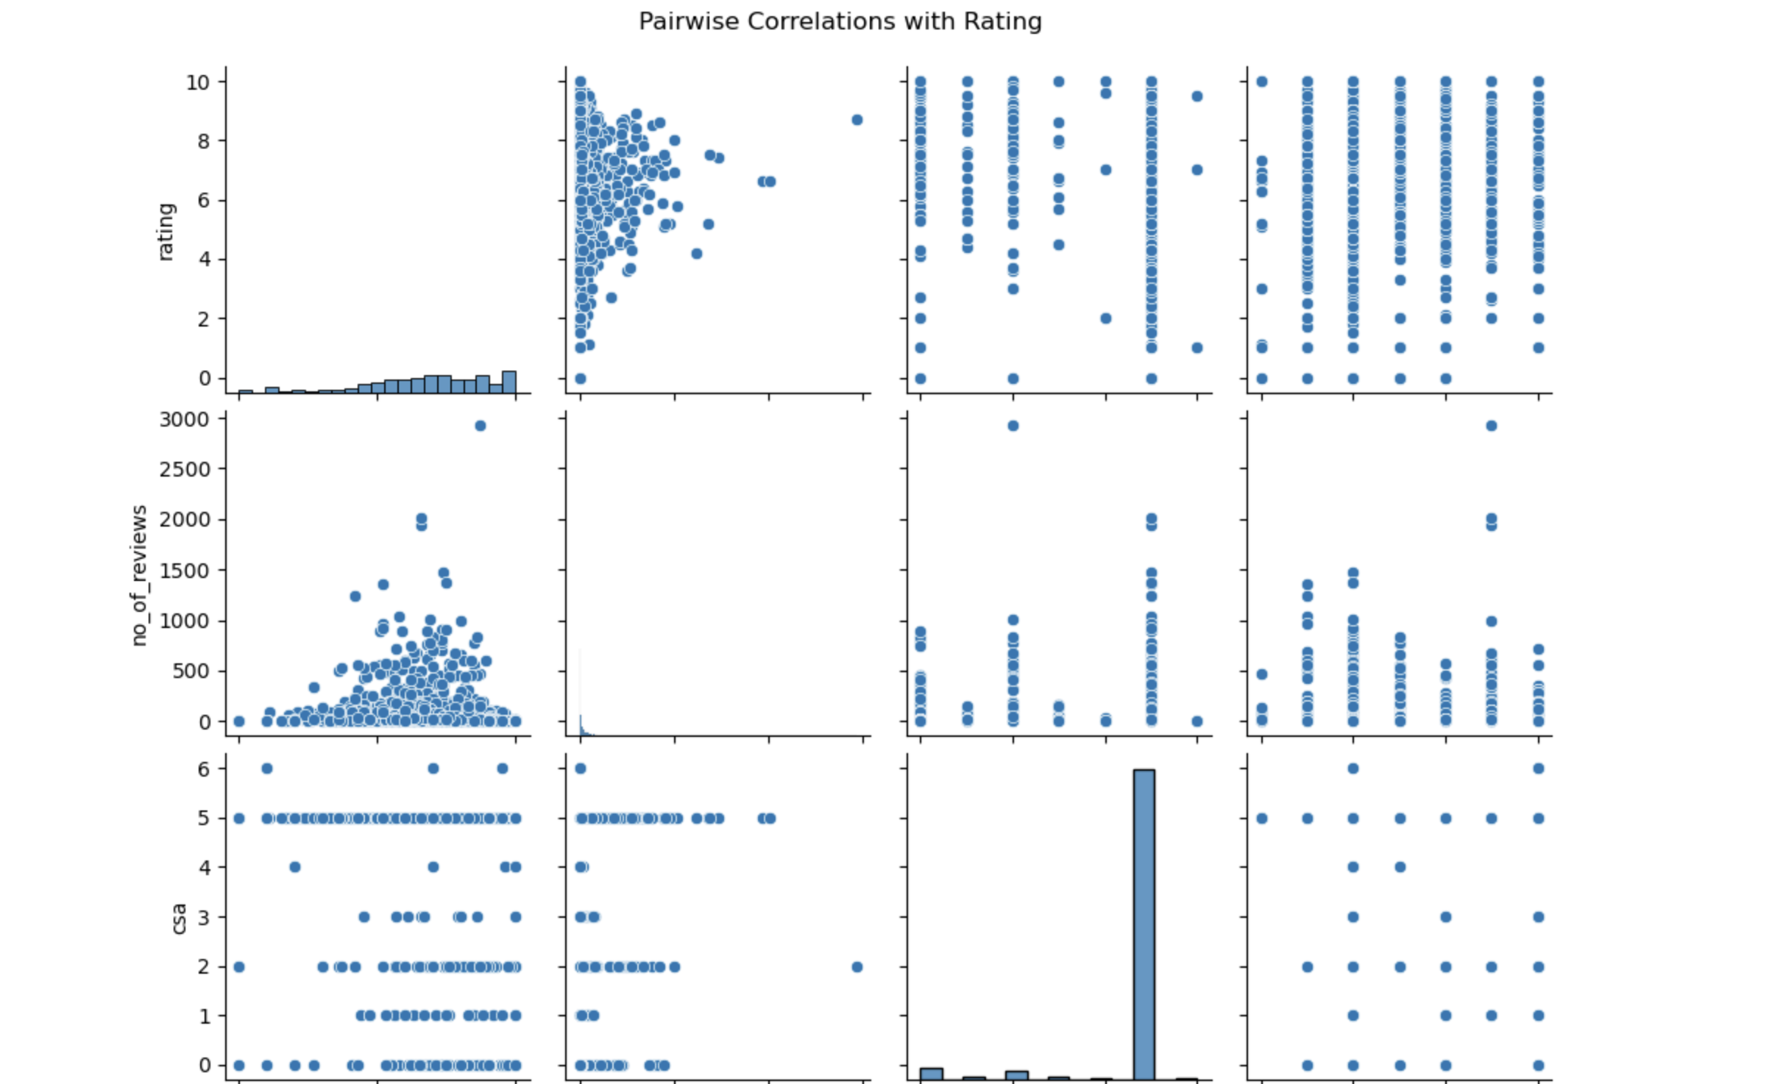

Slide 40
Summary
Through EDA, we aimed to uncover key insights from the dataset by focusing on drugs, their side effects, and the conditions they treat.
We explored the distribution of drug ratings, identified the most common side effects, and examined how drug classes and prescription statuses influenced drug ratings.
The analysis helped to highlight patterns such as which drugs are most commonly prescribed for certain conditions and which side effects are frequently reported.

Slide 41
Conclusion
The EDA on the dataset revealed interesting trends in drug effectiveness and safety. For example, certain drug classes showed a consistent pattern in side effects, while others had higher user ratings.
These findings can be helpful for healthcare professionals in understanding patient experiences with different drugs and can guide further research into drug efficacy and safety.
Moving forward, more advanced statistical analysis or machine learning models can be applied to deepen the insights gained in this preliminary analysis.

Slide 42
THANK YOU

